Slide 1
DECENTRALAND
A Blockchain-Based Virtual World

Slide 2
What is Decentraland in Blockchain?
Decentraland is a decentralized 3D virtual world platform that allows users to create, explore, and trade digital assets within a shared virtual space. Launched to the public in February 2020, it operates on the Ethereum blockchain, ensuring transparent and secure transactions.

Slide 3
Token/Key Components:
LAND (Virtual Real Estate): These are non-fungible ERC-721 token representing tokens (NFTs) representing individual parcels of virtual real estate within Decentraland. Each LAND token is unique and can be purchased, developed, and sold by users.
MANA(Cryptocurrency): This is Decentraland's native cryptocurrency, used to facilitate transactions such as purchasing LAND, virtual goods, and services within the platform. MANA operates on the Ethereum blockchain as an ERC-20 token.
DAO (Decentralized Autonomous Organization): Decentraland is governed by a Decentralized Autonomous Organization (DAO), which enables MANA and LAND holders to participate in decision-making related to platform policies, developments, and treasury management.

Slide 4
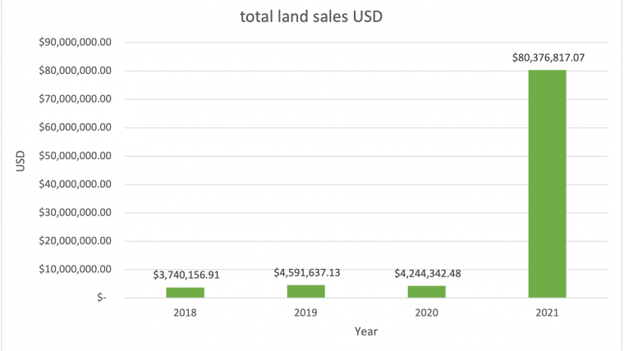
Notable Developments:
Virtual Real Estate: The platform has witnessed significant virtual land transactions, starting with parcels selling for around $20 in 2017 and surging past $100,000 during the NFT boom in 2021. Notably, there was a record-breaking sale of $2.4 million in Decentraland's 'Fashion Street' district in November 2021. Additionally, the total LAND sales in Decentraland amounted to approximately $80,376,817.07, representing the total value of all LAND transactions during that year.

Slide 5
Real-World Use Cases:
Corporate Engagements: Major brands and institutions, such as Sotheby's and samsung, have established virtual presences in Decentraland, hosting events and creating digital storefronts. Gaming & Entertainment:
Play-to-Earn (P2E) Games: Users can participate in blockchain-based games and earn MANA or NFTs as rewards.
Live Concerts & Events: Artists like Deadmau5, Travis Scott, and Paris Hilton have hosted virtual performances.
Social Gatherings: Users can attend virtual parties, fashion shows, and corporate meetups in a fully immersive experience.
Branded Experiences: Major brands like Atari, Adidas, and Samsung have built interactive experiences for users.

Slide 6
Future of Decentraland:
Adoption by Businesses:
More brands entering the metaverse. Example- Metaverse Store: Adidas launched a virtual store in Decentraland, allowing users to explore and purchase NFT-based merchandise.
Technological Advancements:
Upgrades to improve user experience and scalability.
Integration with Other Metaverses:
Potential collaborations with other virtual worlds. Such as- Decentraland and The Sandbox, both blockchain-based virtual worlds, have explored cross-platform events.

Slide 7
Conclusion
Decentraland is a pioneering project in blockchain-based virtual worlds, offering users true ownership of digital assets through NFTs and cryptocurrency. It provides a decentralized, user-driven governance model where MANA and LAND holders influence platform decisions.
With growing adoption by businesses, artists, and developers, Decentraland is shaping the future of virtual real estate, gaming, and social interactions. As blockchain and metaverse technology evolve, future developments—such as interoperability with other metaverses, AI-driven interactions, and enhanced VR/AR experiences—could redefine digital economies and expand the broader metaverse ecosystem.

